Slide 1
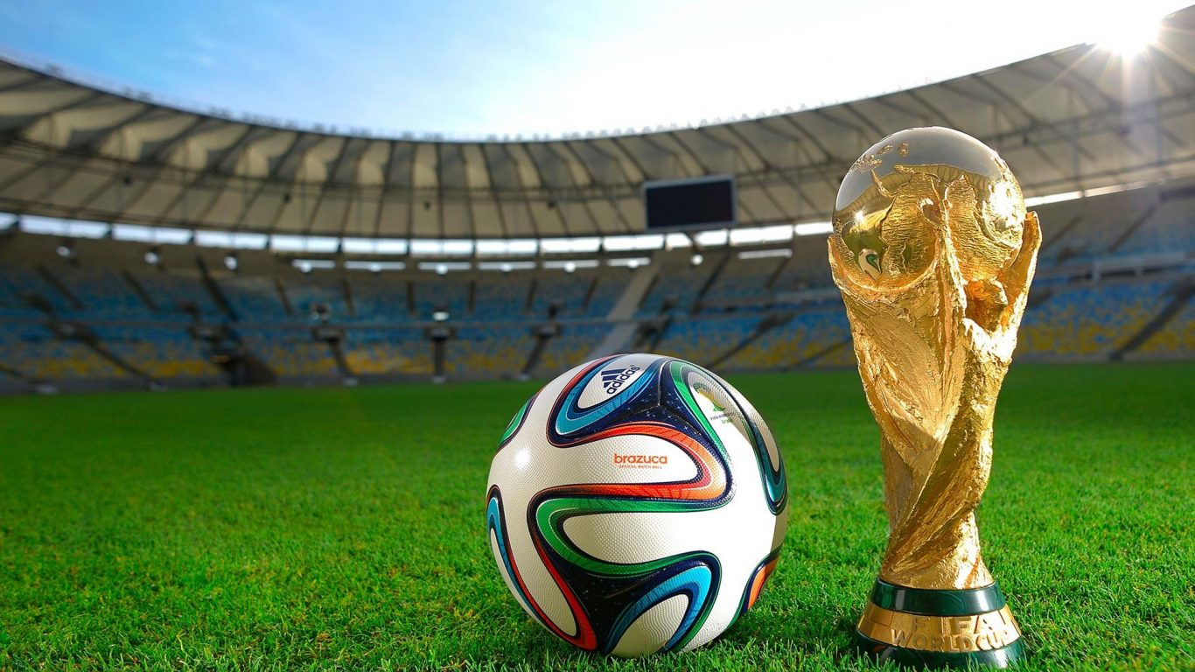
FIFA WORLD CUP ANALYSIS
By Velpula Purushotham
Email ID:Purushothamvelpula80@gmail.com

Slide 2
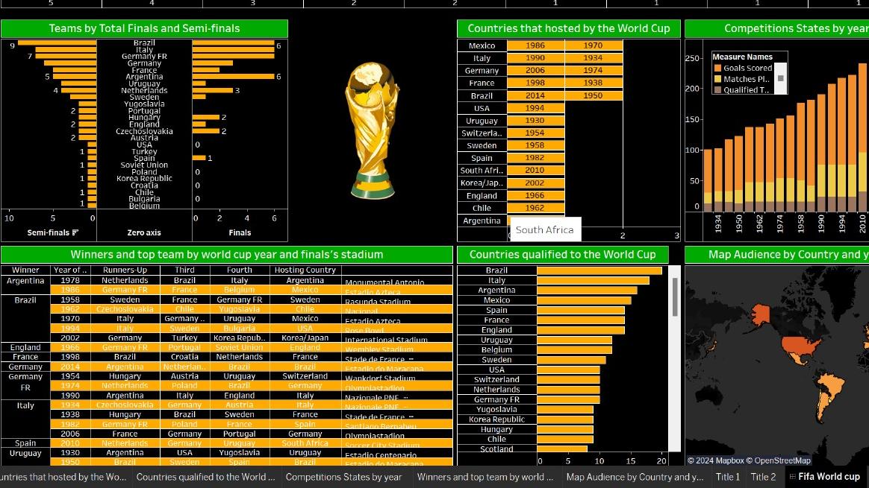
FIFA World Cup Analysis Dashboard

Slide 3
This FIFA World Cup dashboard provides a comprehensive overview of tournament history, highlighting key statistics and trends. It shows the number of titles won by various countries, with Brazil leading the chart, and also displays teams' appearances in finals and semi-finals, where Brazil, Italy, and Germany FR dominate. The dashboard lists the countries that have hosted the World Cup, along with a timeline of competitions showing goals scored, matches played, and teams qualified over the years. Additionally, it includes a table of World Cup winners, runners-up, and the hosting venues, along with a map visualizing audience engagement by country across different years.

Slide 4
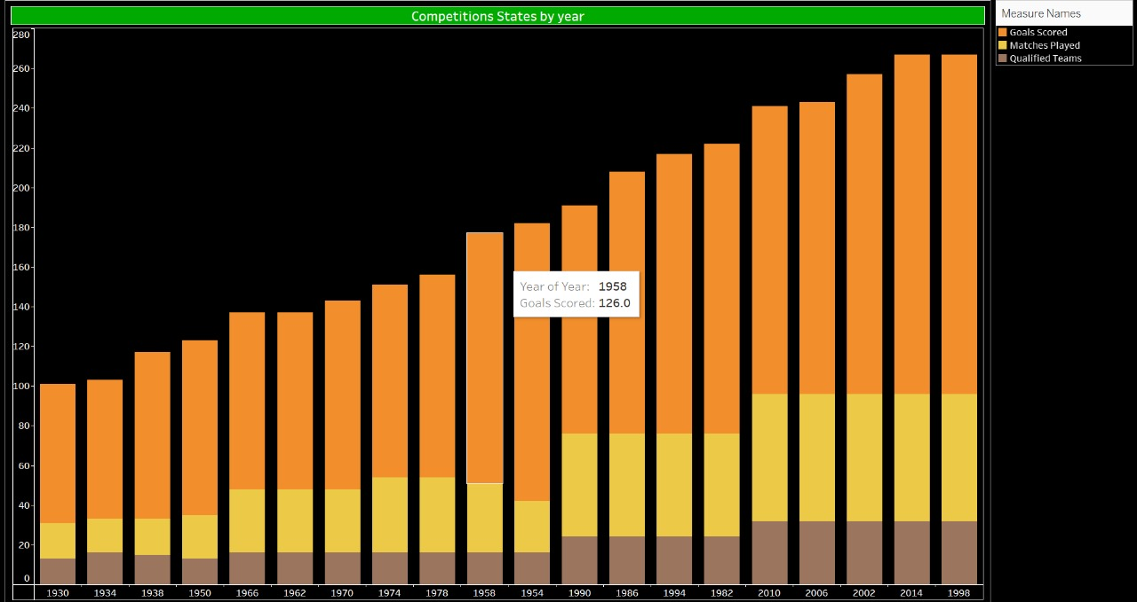
Competitions States by Year
From 1930 to 2014, the FIFA World Cup showcased legendary teams and unforgettable moments. Uruguay won the first tournament in 1930, with Italy dominating the 1930s. Brazil emerged as a football powerhouse, winning five titles, including three between 1958 and 1970. Germany and Argentina also made their mark, with victories in multiple decades. By 2014, Germany had claimed their fourth title, defeating Argentina in a thrilling final, capping a tournament that saw record-breaking attendance and goal-scoring. The World Cup's history reflects the evolving global passion for football.

Slide 5
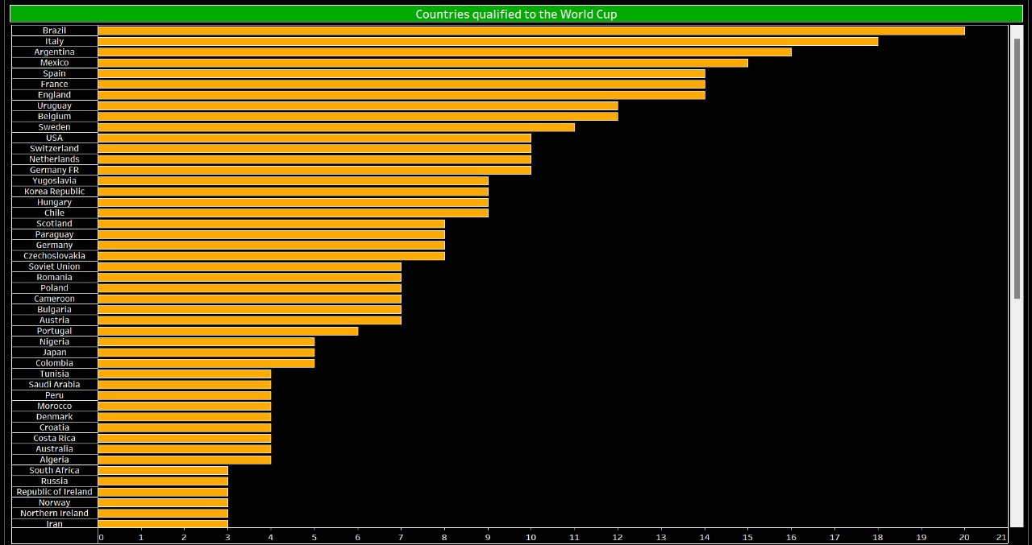
Countries Qualified to the World Cup
The list of countries that have qualified for the FIFA World Cup includes all teams that have participated in the tournament from its inception in 1930 through 2014. These teams represent a diverse range of nations from across the globe, reflecting the widespread appeal and competitive nature of international football. Among the most successful are Brazil, Germany, and Italy, which have consistently qualified and performed well in the tournament. Other notable countries include Argentina, France, and England, each with their own storied histories in World Cup competition.

Slide 6
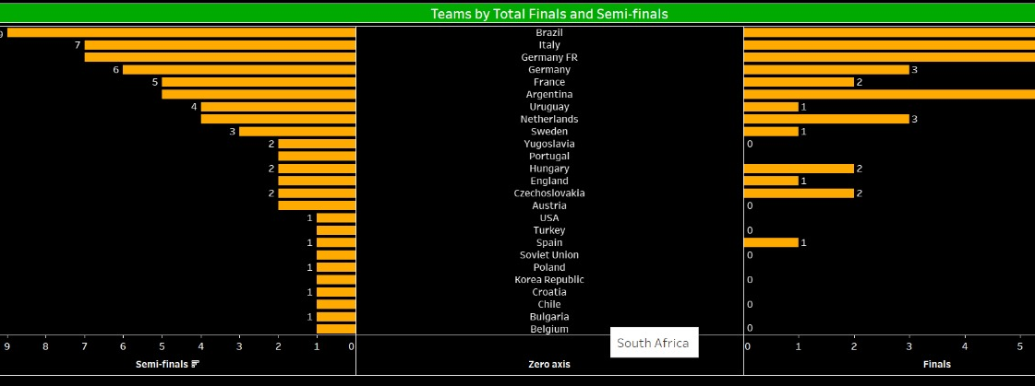
Teams by Total Finals and Semi-finals
The teams with the most appearances in World Cup finals and semi-finals include football powerhouses like Brazil, Germany, and Italy. Brazil leads with numerous finals appearances, having won the tournament five times. Germany and Italy also frequently reach the latter stages, with multiple finals and semi-finals under their belts. Other notable teams include Argentina and France, each with a strong history of deep tournament runs, often making it to the finals or at least the semi-finals.

Slide 7
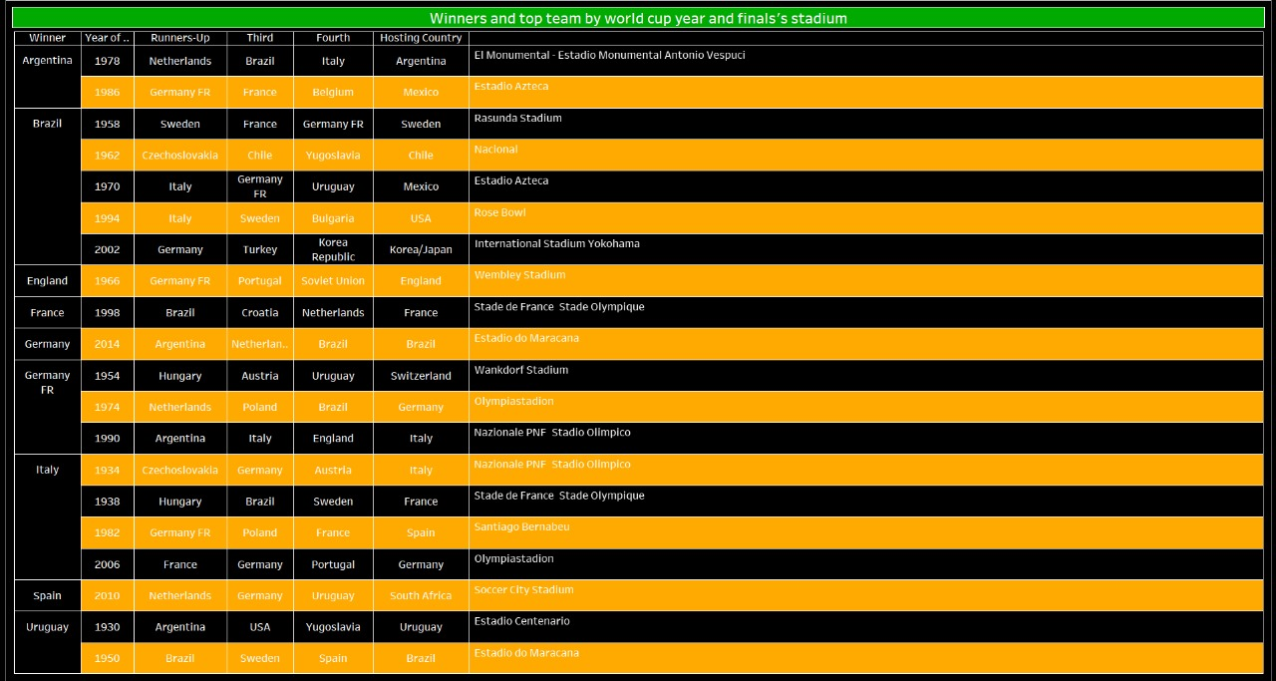
Winners and top team by World Cup Year and final’s Stadium
Each FIFA World Cup has been marked by historic victories and iconic venues. For example, in 1930, Uruguay won the inaugural World Cup at the Estadio Centenario in Montevideo. Italy claimed victory in 1934 at the Stadio Nazionale PNF in Rome, and Brazil won their first title in 1958 at the Råsunda Stadium in Sweden. Other memorable finals include England's 1966 win at Wembley Stadium and Germany's 2014 victory at the Maracanã Stadium in Brazil. Each final has crowned a champion in a stadium that often becomes a part of football lore.

Slide 8
THANK YOU

